Slide 1
GUI Automation & Selenium
Luke Burkholder
Mar 21 2013
Notes:
Copyright 2013 FUJITSU LIMITED

Slide 2
Introduction – Who am I?
Regina(ish) born and raised
Automation Developer Consultant @ Fujitsu
Notes:
Copyright 2013 FUJITSU LIMITED

Slide 3
What is GUI Automation?
A tool to automate the actions of software as if a human user was clicking the mouse themselves
Primarily used to automate regression and performance tests, but can be used for other purposes as well.
Notes:
Copyright 2013 FUJITSU LIMITED

Slide 4
Why should a test be automated?
For the same reasons anything should be automated
  Repeated (manual) work is inefficient (manual) work
  Improve regression testing time from days to hours

Slide 5



A Few of the Tools Available

Slide 6
Selenium
Started in 2004 at ThoughtWorks for the testing of an internal app
Eventually open-sourced, with Selenium RC added to get around the JS 'same origin policy'
Selenium IDE (which we'll talk about in a minute) was made in Japan by a single volunteer
Google got involved and built the Selenium Grid (which I'll also mention later)
Current version of Selenium scraps RC and replaces it with the WebDriver

Slide 7



Parts of Selenium
Selenium IDE
A Firefox addin
that allows semi-
technical users
to record quick
scripts
Selenium WebDriver
Uses 'real'
code to drive
a browser
locally or on
ONE server
Selenium Grid
Uses WebDriver to drive browsers on MULTIPLE servers, even ones on the cloud.

Slide 8
The Two Schools of Thought
'Record-Playback'
Pros:
  Easy
  Fast
Cons:
  Can be difficult to maintain
  No reusability of function
'Programmatic'
Pros:
  Flexibility
  Reusability
  Can be easier to maintain
Cons:
  Requires a developer
  Slow

Slide 9
Demo 1 – Selenium IDE (Record-Playback)

Slide 10
Demo 2 – Selenium WebDriver

Slide 11
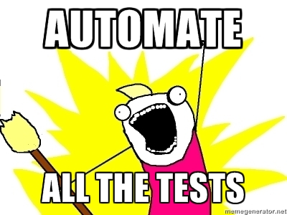
A Potentially Problematic Proposition...

Slide 12
Why is this a problem?
For projects currently in development, some parts of the AUT will be unstable.
Not every test will be run frequently, or even more than once.
What if the technology of the AUT changes?
What if the requirements of the business are not being met?

Slide 13
Questions?
Email: luke.burkholder@ca.fujitsu.com
Twitter: @riddari
Slides and Code: bit.ly/RTCAutomation
The End

